Slide 1
Instructions-Please Read Carefully
With the PHEP E7 exercise requirement for the 2018-2019 grant year, MT DPHHS created these scenarios to assist local health jurisdictions in carrying out disease table top exercises. As you prepare to conduct a table top exercise, consider the following:
Choose someone to conduct the exercise
  Public health will participate, so finding another party to manage the table top may be helpful
Choose how much time you want to spend on the exercise
  CDEpi designed these to run for approximately 1-1.5 hours, but you know your jurisdiction and may elect to more time.
  The focus of this exercise is not the disease! It’s about using your communicable disease response plan and other emergency plans. Don’t worry about the specifics of the disease, focus on how you will work with your local partners. There is some detailed clinical information to emphasize the complexity of these situations, but it is not the primary reason for this exercise.
  You can write the PHEP RC2 media release during the exercise, if time allows, but you can also elect to do that after the exercise.
Review the resource material and slides prior to the exercise
  Public health staff should brush up on their department response plans, and additional resources are available (see the next slide for a list)
If you are inviting a large number of people, having discussion among groups at tables and reporting out to the group key findings (like CDEpi does during trainings) may help manage discussion
This is your exercise. However, if you want to change aspects of the injects (prompts), be very cautious. The guidance provided after each inject and discussion is very specific to the injects provided. Changing the injects may alter what guidance is necessary.

Slide 2
Resources-Review
Montana Code Annotated (MCA)
  MCA 50-1-102, General Powers and Duties
  MCA 50-2-116, Powers and Duties of Local Boards of Health
  MCA 50-2-118, Powers and Duties of Local Health Officers
  MCA Title 50, Chapter 16 -- Health Care Information
Administrative Rules of Montana (ARM), 37.114.101 to 1016
Control of Communicable Disease Manual (CCDM) adopted by reference in ARM 37.114.201(2)
“Guidelines for Isolation Precautions in Hospitals.” Adopted by reference in ARM 37.114.101(9)
“Manual for the Surveillance of Vaccine-Preventable Diseases,” Chapter 7: Measles, found on the CDC Websites at https://www.cdc.gov/vaccines/pubs/surv-manual/chpt07-measles.html .
See the Epi Resource Page for examples of messaging and other materials.

Slide 3
Communicable Disease Table Top Exercise
Suspect Measles in an Unvaccinated Traveler

Slide 4
Objectives
Exercise activation of the local health jurisdiction public health emergency response plans:
  Activation of emergency response operations
  Case confirmation
  Laboratory testing considerations with emergency specimen transport
  Mandatory exclusion of susceptible populations or enforcement of public health law
  Public health management of contacts
  Communication with public and response partners
Engage local public health partners in an exercise to clarify roles in response.
Identify gaps and strengths in emergency preparedness plans:
  Public health
  Coordinating response plans with partners (hospital preparedness, DES, etc.)

Slide 5
Why is DPHHS asking us to conduct this exercise?
In 2016, local health jurisdictions were asked how prepared they were to respond to a communicable disease event:
  About two-thirds of jurisdictions did not feel prepared to enact non-pharmaceutical interventions (steps taken that may include isolation or quarantine) when necessary
  About one-third of jurisdictions did not feel fully prepared to perform communicable disease surveillance and investigation activities
Gaps were identified in real-life disease events in the past two years

Slide 6

A few things to consider…
This scenario is designed to test your local response to a suspect or confirmed public health threat.
Artificialities may occur depending on your jurisdiction’s size and resources.
The time it will take to run this exercise will vary depending on your assembled team.
Format:
  INFORMATION bulleted in green
  QUESTIONS/DISCUSSION POINTS bulleted in red
    Stop the slides when you see red, and the answers or guidance information will be on the following slide or slides.
  ANSWERS bulleted in blue and italicized

Slide 7
Partners and Applicable Plans
APPLICABLE PUBLIC HEALTH PLANS/ANNEXES/STANDARD OPERATING PROCEDURES
  ALL-HAZARDS PLAN
  COMMUNICABLE DISEASE RESPONSE PLAN
  NON-PHARMACEUTICAL INTERVENTIONS PLAN (MAY BE TITLED AN ISOLATION AND QUARANTINE PLAN)
  LABORATORY SAMPLE TRANSPORT PLAN
  HEALTH ALERT NETWORK (HAN) PLAN
  RISK COMMUNICATION POLICIES AND/OR CRISIS AND EMERGENCY RISK COMMUNCATION PLAN
Recommended partners in this exercise:
  Local Health Officer
  Lead Local Health official
  Local County Attorney (If Possible)
  Board of Health Members
  Public health Communicable disease Staff
  Infection Preventionist/Infection control staff from local hospital(s)
  Healthcare Provider (If Possible)
  Laboratory personnel
  School administrators and nurses
  Other local partners you wish to include, such as Disaster and Emergency Services staff

Slide 8
Scenario
A nurse working a local school notifies the local health department of an adolescent with a rash and fever who recently had travel to Indonesia with family. The child has no history of any vaccination, and has been home for two days. The mother called the school and reported the child is quite ill, and will seek medical care today for the child. The nurse was particularly concerned about the non-vaccinated status of the child and potential vaccine-preventable diseases the child might have.
What questions would you ask the nurse during that call?
What information would public health like to obtain for your case investigation?

Slide 9
Gather information
Ask the caller for:
  Demographic and contact information of the case and parents;
  Where they will seek care;
  What signs and symptoms were reported;
  Where and when the travel occurred;
  Vaccination status of the child;
  Let the caller know public health will look into the case, but may have to call back for more information.

Slide 10
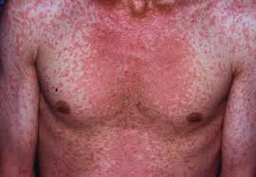
Initial findings
The nurse is able to give you the demographics of the sick child, contact information of the parents, and that the parents plan to seek care in the local emergency room.
She also states that the mother reports a fever of 104° F and the child is very lethargic.
The school has a religious exemption to all vaccines on file for the student.
She does not have exact information about the recent travel or rash, but the mother states the rash covers the child’s entire body, and that they returned from Indonesia about a week ago.
What are your next steps?
  Suggested discussion length-5 mins

Slide 11

Emergency Room Assessment
Public Health calls the ER, and finds the patient is already there.
  Currently, the patient is in a four-bed ER exam room
  Mother and father are at bedside
  Provider examination shows a maculopapular rash in the same stage of development across the body
  No exudate or crusting is observed on the rash
  White patches are present in the mouth on the gums
  Eyes are reddened and watery
  Fever is currently 102° F
What additional information does public health need?
  Suggested discussion length-1-2 mins

Slide 12
Emergency Room Assessment
Details of travel history: dates, places visited
Any recent international visitors? Visitors from out of state?
Characteristics of the rash and other clinical symptoms
What testing has been ordered?
Resources that can be provided by public health to the hospital
How should staff manage the patient for now?

Slide 13
Travel History
Ask for a travel history three to four weeks prior to the onset of symptoms:
  International travel
  Travel within the US
Identify dates of travel and individuals with whom they have traveled
  Is anyone else similarly ill? Where are they?
  Were you around anyone who was ill?
  If so, where were they?

Slide 14
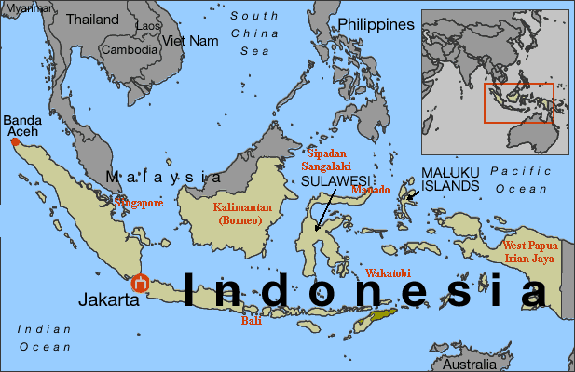
Travel History
When asked, the patient and her family tells you that the entire family left for Indonesia one month ago to join a church mission group in Jakarta.
  Their activities there consisted of building a school, and they stayed in a camp near the building site.
  They returned exactly one week ago and have not been out of town since then.
  No one else is ill within her family, but they were around a number of similarly ill children while in Jakarta. The cause of their illness is not known.
What else would the healthcare provider/hospital and public health like to know about the rash?
  Suggested discussion length-1-2 mins

Slide 15
Rash Characteristics-What to Ask
Physical appearance
Onset characteristics
Is there any fluid coming from the rash?
Is there scabs or crusting present?
Is it painful/itchy/burning, etc.?
Is it mostly vesicular, papular, macular, or a mixture of each?
What color is it in general?
Is it peeling, cracked, or does it have open areas?
Where did the rash start?
Where is it distributed on the body?
How quickly did it develop?
Did the appearance change over time?

Slide 16
Rash Characteristics
When asked, the patient’s parents tell you:
The rash started two days ago
The rash is red in color, and it started on the patient’s hairline.
The rash spread quickly to the rest of the patient’s body.
Her skin is intact without drainage from the lesions.
The fever started two days before the rash.

Slide 17
The provider suspects the following conditions based on presentation:
Rubella (German measles)
Rubeola (Measles)
Varicella (chickenpox)
Measles and German measles are most likely based on presentation and exposure
  Indonesia has ongoing measles and German measles activity (endemic transmission)
  Chickenpox also a possibility with local exposure, but rash is not typical of chickenpox
Other conditions are a possibility, but are not pertinent to this exercise

Slide 18
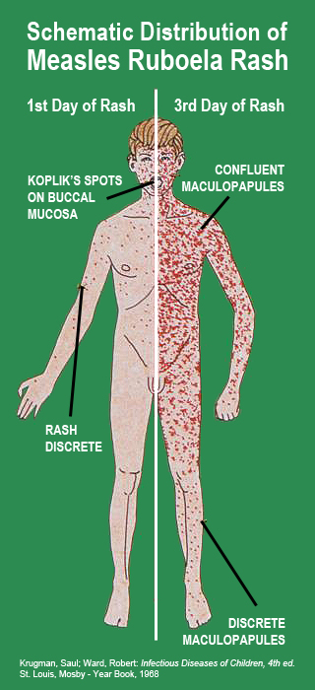
Rubella and Measles Rash Characteristics
Rubella

Slide 19
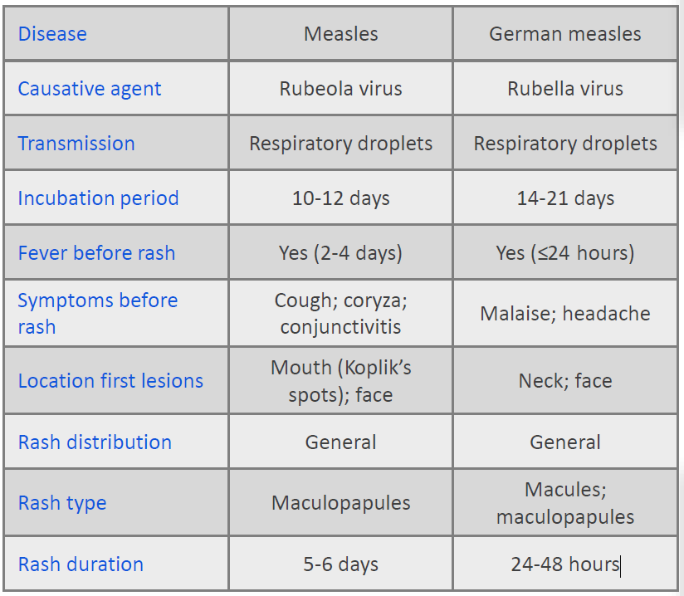
Measles vs. Rubella: Signs and Symptoms

Slide 20
Assess what you have so far…
The provider notified local public health of the suspect case, who should now be notified by local public health?
  Local health officer?
  Local health board?
  CDEpi?

Slide 21
Pubic Health Notification
In this scenario, public health is involved from the beginning. In incidents involving communicable disease, notification should happen early in the process.
  Call public health via your local 24/7 number immediately when a reportable condition is suspected or confirmed.
  If you cannot reach your local public health office, you may call CDEpi at our 24/7 number (406-444-0273).
  Local public health should notify CDEpi as soon as measles is suspected (per ARM 37.114.204: 24 hours)
Public health can provide:
  Guidance on confirmatory testing
  Public health case management and control measures
  Guidance on public messaging
  Management of contacts
  CDC consults, when requested
  Depending on the situation, other resources are available too.

Slide 22
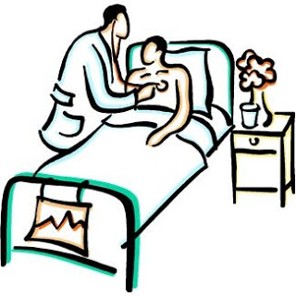
Hospital Considerations
At this point, what should the hospital do to manage the patient?
What messaging should be given to staff who are potentially exposed?
What actions should the hospital do at this point to identify potentially exposed patients and visitors?

Slide 23
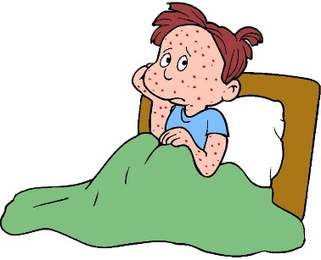
Recommended Hospital Actions
Institute airborne precautions, and continue standard precautions until measles is ruled out
Vaccination for measles for those who are not vaccinated or under-vaccinated can be done (because of the concern, they may be very motivated to vaccinate)
  DPHHS likes to use any reason to vaccinate!
Compile a list of those potentially exposed (staff, visitors, and patients) and their MMR vaccination/immunity status
Measles is highly infectious, but most healthcare workers should be immunized or have shown proof of immunity
Work with public health on case investigation, messaging to staff, and case management
Inform staff members that at this point measles is suspected, but not confirmed, and you are working to diagnose the cause of the rash

Slide 24

Laboratory Testing
The provider would like to order laboratory testing to confirm or exclude rubella, rubeola, and varicella (German measles, measles, and chickenpox)
What testing is preferred in this situation?
Where would you order it?
How quickly can you obtain results?

Slide 25
Laboratory testing
PCR is preferred as it detects dead or live virus
Serology is less desirable because it does not always differentiate between immunity or disease
Testing is available from the Montana Public Health Laboratory
  Rubella and Measles PCR testing in a stat situation would be 6 hours from receipt of the specimen.
  If a Rubeola or Rubella IgM is necessary, results are available in 2-3 days (sent to North Dakota PHL).
In this situation, you find out that the testing you require is only available from MTPHL.

Slide 26

Laboratory Testing
The courier system for MTPHL is down and it is not clear when the service will be back up again.
According to your local laboratory sample transport plan, what do you do?

Slide 27
Laboratory Sample Transport Plan
All local health jurisdictions are required to maintain a plan specific to their resources in order to send samples to MTPHL on an emergent basis: Laboratory Sample Transport Plan (LSTP)
Work with CDEpi by dialing 406-444-0273, and we will help coordinate sample testing and arrival at MTPHL during a case investigation
Advice on packaging, forms, sample handling are also available from MTPHL

Slide 28
Testing Results
The appropriate specimen is sent to MTPHL and PCR results are positive for measles.
What are your next steps?
  Suggested discussion length-5 mins

Slide 29
Assess what you have now…
Isolate patient until 4 days after rash onset
Activate EPI Team
Contact investigation
Prophylaxis for appropriate contacts
Messaging
Reporting
Monitor for new cases

Slide 30
Activate EPI Team
According to your local disease response plans, who is on your epi team?
Would you activate your public health emergency plans? Which ones?
This will be specific to your jurisdiction, so refer to your health department emergency operations plans for guidance.

Slide 31
Messaging
Think about the messaging that needs to be performed between public health, the hospital, the care facility, and the local healthcare partners:
  Local partners (i.e.-school, hospital, local healthcare providers), what information do you need from public health?
  Public health-what do your communicable disease response, risk communications, and Health Alert Network (HAN) plans say you should do?

Slide 32
Messaging between Public Health and Partners
A HAN message is recommended to surrounding healthcare partners
  Those who feel they have been exposed when word circulates about a measles case may appear at providers offices for testing
  Information regarding measles can be distributed quickly to healthcare providers
The affected healthcare facilities will require messaging, as well:
  Staff at the hospital may have a questions and concerns regarding their potential exposures
  Perceived risk from exposure to the patient may not be actual risk (worried-well)
Identify a route to manage the reports as they come in

Slide 33

Contact investigation
Who is considered a contact?
What locations were visited by the patient?
What time frame is included?

Slide 34
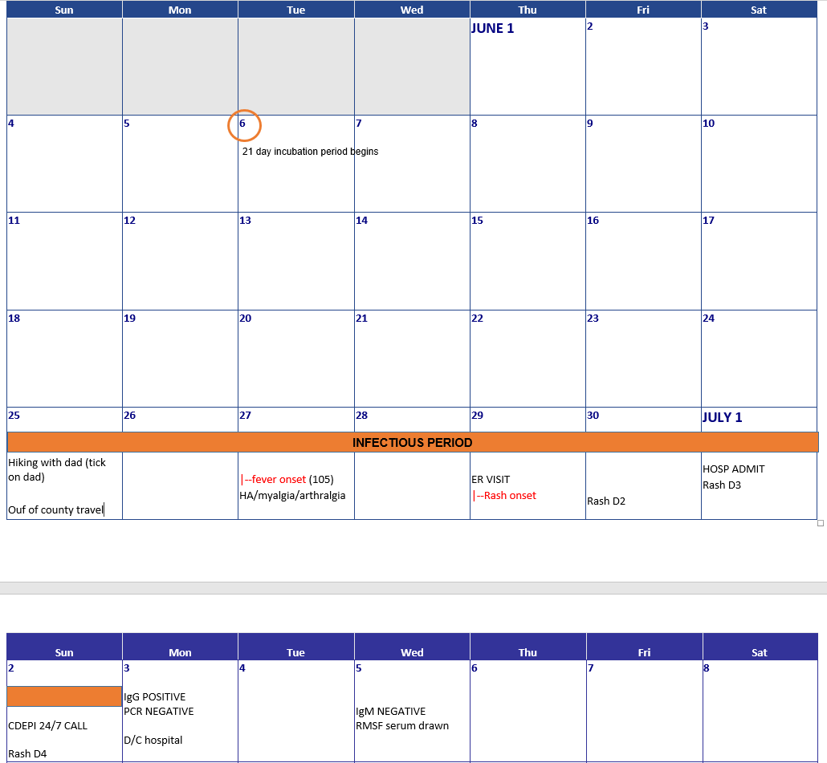
Contact investigation
Establish timeline!
Incubation period: 21 days prior to onset of symptoms
Infectious period: 4 days before onset of rash through 4 days after onset of rash
Determine where patient was during the infectious period

Slide 35
Contact investigation
WHERE | WHO | WHEN
Household | Household contacts | Infectious period
Classroom, common spaces (cafeteria, gym, library) | School contacts | From beginning of infectious period until last day attended school prior to onset
Church | Youth group contacts | Day(s) that case attended youth group during infectious period
Church | Church contacts | Day(s) that case attended services during infectious period
Emergency room | Medical staff | During office visit + 2 hours
Emergency room | People in waiting room | Patient arrival + 2 hours
Grocery store | Grocery store customers/staff | Time spent in store + 2 hours

Slide 36
New information
Contact investigations determined that there are 4 unvaccinated contacts
  2 in the school with religious exemptions
  2 from waiting room at ER who are too young to be vaccinated
How can public health and their partners protect these contacts?

Slide 37

Prophylaxis - vaccination
Recommended for:
Individuals without documented evidence of immunity
Immunocompromised individuals
Can be done in the health department or by a private provider
Not recommended:
Infants <12 mos of age
Pregnant women
Vaccinated individuals
History of disease (e.g., born before 1957)
*Kids can return to school immediately after vaccination (per CDC)

Slide 38
Prophylaxis – Immune Globulin (IG)
Recommended for:
Individuals at high risk for complications due to measles infection
  Immunocompromised individuals
  Pregnant women
  Infants <12 mos of age
Consult with providers regarding IG administration

Slide 39
Control measures
Of the 4 individuals identified through contact investigation:
2 were too young to receive vaccine – the time spent in the waiting room was short and both infants were in a parent’s arms/carseat and did not handle any toys in the waiting area. Healthcare providers elected to not give IG to either infant and instead will watch and wait for symptoms.
The remaining 2 are classmates, 1 of whom elected to receive the MMR vaccine. The other refused.
What other control measures are available?
When do you consider exclusion of individuals from high-risk settings?
Who are your partners and how can they assist?

Slide 40
Control Measures
Exclusion
  Is there an outbreak?
  Typically in a setting where the individual would not be safe from acquiring disease
  Any students not up to date for MMR vaccination
  Sometimes can work with HCP to receive vaccination rather than exclude
  Consult with CDEpi prior to exclusion decisions
Quarantine of asymptomatic, unvaccinated contacts
  Rarely utilized
  At the discretion of the health department AND consult with CDEpi
  Consider risks vs benefits

Slide 41
Public Messaging
Should information be shared? If so, what information.
How will public recipients receive the message?
Who is your point of contact for public inquiry?
How will you coordinate between partners?

Slide 42
Messaging: What?
With communicable disease events, you may not feel it necessary to perform a press release. However, some situations will warrant a public release of some sort, particularly in cases where misinformation is circulating or there is a great deal of concern in the community. Assume in this situation you want to create a press release.
Without identifying the patient:
General information about the disease and its transmission
Signs/symptoms of the disease
Guidance to visit healthcare provider if concerned
Contact information for additional questions

Slide 43
Messaging: How?
Public
  Press release (work with PIO)
  Social media (work with PIO)
  Letter to parents (collaborate with school)
  Letter to church congregation (collaborate with church contact)
The local health jurisdiction risk communication plan should address routes of public information releases

Slide 44
Reporting
Report any out of jurisdiction contacts to DPHHS – will forward to appropriate jurisdiction for follow up
Enter suspect cases in MIDIS – edit and complete as additional information is received
Complete outbreak reporting form and fax to CDEpi

Slide 45
Monitor for New Cases
How long do you watch for new cases?
Who are your key surveillance partners for active surveillance?
How many messages will you distribute?
  Recommended discussion length-5 mins

Slide 46
Monitor for New Cases
Incubation period range = 7–21 days. Monitor for new cases for 2 incubation periods following the onset of the last identified case.
KSP include:
  Local providers
  Local laboratories
  School nurse (or other school liaison)
Continue messaging for as long as you are actively looking for cases.

Slide 47
New Information
Of the 4 at risk individuals identified during contact investigations, 3 developed signs/symptoms of measles and were tested. 2 were positive for measles. The third was ruled out due to a rash due to recent course of antibiotics.
New cases = 2
Total cases = 3
Contact investigations begin for each new case and the clock is reset until 2 incubation periods have passed

Slide 48
Summarize Results
Summary of outbreak
  Outbreak report form
  Coordinate write up with CDEpi (if needed)
After action report
  What worked
  Lessons learned
Adjust plan as needed
Review plan each year

Slide 49
Tabletop Completion
Public health staff, please complete the worksheets provided for the tabletop, and submit them on the PHEP 3rd quarter progress report. This will meet your L1 and E7 exercise deliverables (remember to still perform your CD Response Plan Review checklist, as well, for E7).
To complete your Risk Communications RC 2 deliverable, write a media release related to the chosen scenario using your communications plan, and assess the public information component in this AAR. Upload the media release to your progress report.
Did you identify changes needed in any of your response plan? If so, update your plans, and if you need guidance, contact your MT DPHHS PHEP staff or CDEpi staff.

