Slide 1


HAN
Response and Forwarding 2019 - 2020
Gerry Wheat
Health Alert Network Coordinator

Slide 2
Agenda
HAN Definition
HAN History – (Brief)
Montana’s Performance
  Good News
  Needs Improvement
State Improvement Actions
Guidance for LHJ Improvement Actions
  HAN Development Guidance
  Forwarding Rates
  Turnaround Time
  Cover Sheet
  Target Audience Selection
LHJ HAN Plan

Slide 3
HAN Definition
CDC’s Health Alert Network (HAN) — is CDC’s primary method of sharing cleared information about urgent public health incidents with public information officers; federal, state, territorial, and local public health practitioners; clinicians; and public health laboratories
DPHHS’s Health Alert Network (HAN) — is DPHHS’s primary method of sharing cleared information about urgent public health incidents that could affect people in Montana

Slide 4
HAN History
CDC HAN
September 11th, 2001 - First Official CDC HAN Alert
DPHHS HAN
Before 2010 – Email & Biscom Fax System
2010 – 2014 NotiFind
2015 - ASSURANCE
  This is an official
  CDC HEALTH ALERT
  Distributed via Health Alert Network
  Tuesday, September 11, 2001, 13:25 EDT (01:25 PM EDT)
  CDCHAN-00001-2001-09-11-ALT-N
  SUBJECT: ALERT: Terrorist Activity Response

Slide 5

HAN History
2001
There were 4 Internet connections to
Public Health in Montana.

Slide 6
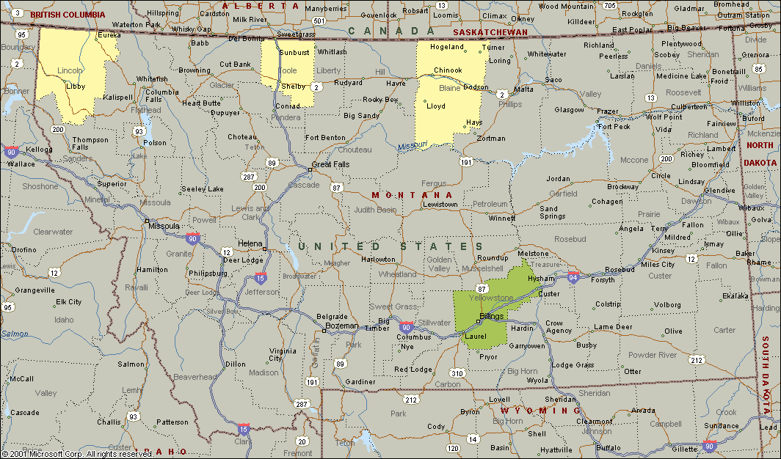
HAN History 3 Dial-up 1 Frame-Relay
Montana Internet Connections 2001

Slide 7
Montana’s Performance
Good News
  All Jurisdictions in Montana Have Faster Internet Connections
  Response Rate — 98% in 2019
  (5) 100% Responses in a row so far in 2019
  Montana Public Health Directory (MPHD) Integration (2012) – Local Contact Updates
  Tracking – ASSURANCE
    Response Times
    Forwarding Rates

Slide 8
Montana’s Performance
Needs Improvement
  Local Staff Coverage/Updating (3)
  Local Cover Sheet Usage
  Update Local HAN Lists
  HAN Message Turnaround Time (1 Week for Advisories and Updates ALERTS – A.S.A.P.)
  Forwarding Rates
  Local HAN Message Format
  Target Audience Selection

Slide 9
State Improvement Plan
ASSURANCE
  Other Messaging Options available (e.g., Text Messages)
HAN Hotline Message
  Recorded by an SME or the RCC
  HAN
  HAN Website at www.han.mt.gov
Metrics
  Forwarding Rate Goal 70%
  Current Average 84%
  Highest Average Forwarding Rate Achieved 84%
HOT LINE
1-800-701-5769

Slide 10

Guidance for
LHJ Improvement Plan
HAN Development Guidance
Forwarding Rates
Turnaround Time
Cover Sheets
Target Audience Selection

Slide 11
HAN Development Guidance
Q: What is your 24/7 procedure for the receipt, review, creation (if necessary), and forwarding of HAN messages?
24/7 Receipt, Review and Forwarding
Content Evaluation and Target Audience Selection
Creation and Development

Slide 12
HAN Development Guidance
1. 24/7 Receipt, Review and Forwarding of HAN messages received from the State or Federal Level
  Work Hour Coverage
Work hours (8:00am to 5:00pm M-F)
Mobile Email Device Use
Email account will be regularly monitored
  After Hours Coverage
HAN Alerts will be sent to all HAN identified devices listed in the Montana Public Health Directory (MPHD).

Slide 13
HAN Development Guidance
2. Evaluating the content of a HAN message received from DPHHS and developing an approval process for forwarding and/or creation of Local HAN Messages
  Message Forwarding - Work Hours
  Message Targeting
  Message Content

Slide 14
HAN Development Guidance
2a. Message Forwarding - Work Hours
Q: When should the message be forwarded?
Forward as soon as possible if an Alert. (<1 hour)
Forward during regular work hours if an Advisory or Update in 7 days or less.
Forward during regular work hours if an Info Service at your discretion.
 | Alert | Advisory | Update | Info Service
Distribute | ASAP | 7 Days or Less | 7 Days or Less | @Will
Distribute at your Discretion | @Will | @Will | @Will | @Will
Do Not Distribute | X | X | X | X

Slide 15
HAN Development Guidance
2b. Message Targeting
Q: Who should receive the message?
Use Distribution Lists
Use Appropriate Method to Send Information out to health partners
Include your own staff

Slide 16
HAN Development Guidance
2c. Message Content
Q: What should the message say?
Do not change the content of the CDC or DPHHS HAN messages
  DPHHS HAN Messages are sent out as a PDF to help prevent editing and loss of imbedded links to additional information
Add additional information if necessary to improve/update the content of the message
Add local contact information

Slide 17
HAN Development Guidance
3. Originating a HAN Message Based on a Local Situation(s)
Q: What process will you go through when your local health department needs to create its own HAN message?
Templates
Epi Team
Health Officer Approval
Delivery Method
Responses
Expectations

Slide 18
Forwarding Rates
DPHHS has sent you a HAN message. What are some of the things you need to think about?
Level of HAN Message – Alert, Advisory, Update or Info Service
Distribution Recommendation – Distribute, Limited Distribution, Distribute at Your Discretion and Do Not Distribute
Audience – All or a select group
Forwarding – Always send the HAN message to the HAN e-mail box hhshan@mt.gov otherwise it will NOT count as a forward.

Slide 19
Forwarding Rates
The current average: 84%
DPHHS only tracks the forwarding of messages which LHJs are asked to forward.
Replace Coversheet with your LHJs
Local content can be added
Include hhshan@mt.gov on all HAN messages.
Forwarding Rate Time (1 Week) ADVISORIES and UPDATES
ALERTS – A.S.A.P.
Rule of Thumb: Forward A.S.A.P.
Remember to forward to your own staff

Slide 20
Turnaround Time
Improvements
  Staff Coverage
  Template Usage
  Copy and Paste
  Predefined Distribution Lists (by Pre-identified Target Audiences)
    Clinicians
    Sanitarians
    Pediatricians
    Hospitals
    Schools
    Long-Term Health Care Providers
    Food Establishments
  Help

Slide 21
Cover Sheet
<40% of LHJs use Cover Sheets
All LHJs in Montana have Cover Sheets
Purpose — Target audience will need this information
  Priority Level
  Date/Time
  HAN Title/Subject
  Disseminator (w/ logo)
  Local Contact Information
    24/7 Disease Reporting Number
  Information Sharing Instructions
All information Should be Local/Tribal

Slide 22
Target Audience Selection
Q: Have you considered?
Pharmacies
School Nurses
Local Laboratories
Law Enforcement
EMS
Long Term Health Care Facilities
Higher Education Facilities
Sanitarians
Others???
Consider in some events you may want to exclude some audiences; therefore, having some prebuilt target audience lists may be a good idea. Think of a few occasions when you may want to exclude some audiences

Slide 23
LHJ HAN Plan
HAN Plan Structure
Essential Elements

Slide 24
HAN Plan Structure
Title Page
Record of Change
Record of Distribution
Section I — Purpose, Scope, and Assumptions
Section II — Concept of Operations
Section III — Roles & Responsibilities
Section IV — Maintenance
Section V — Appendixes List
  Appendix A — HAN Standard Operating Procedures
  Appendix B — HAN Coversheet Template
  Appendix C — HAN Information Sheet Template
  Appendix D — Local HAN Contact List

Slide 25
Essential Elements
DPHHS Recommends That Local HAN Plans/Protocols Include:
Procedures for Receiving and Responding to the HAN Message.
Procedures for Forwarding the HAN message if Necessary.
List(s) of Local HAN Contacts With Contact Information Updated as Needed.
  Local Contacts call DPHHS to be removed from the Local Health Departments List.

Slide 26
Essential Elements
DPHHS Recommends That Local HAN Plans/Protocols Include:
A List of Communication Equipment Used in Your Local HAN System. Fax Systems
"After-Hours" Contact Information for the Public Health Department or Tribal Health Agency Included in the Plans/Protocols.
A Local Cover Sheet to Forward HAN Messages.

Slide 27
Essential Elements
DPHHS Recommends That Local HAN Plans/Protocols Include:
The Four Categories of HAN Messages.
  ALERT
  ADVISORY
  UPDATE
  INFOR SERVICE
The Four Levels of Distribution: Distribute, Limited Distribution, Distribute At Your Discretion, and Do Not Distribute.
A Record of Changes Page: To track changes in the document.

Slide 28
HAN/SNS MCM
Update Contacts before November 18th.
HAN Test of the 3 Local HAN Contacts in each jurisdiction.
Make sure your 3 Local HAN Contacts are up-to-date on the testing day.
Everybody Responds
November 18th
TEST TEST TEST

Slide 29
The End
Questions?

