Slide 1

Redesignation of Hill County Older Americans Act Services
Public Hearing
March 21, 2024

Slide 2

Agenda
Older Americans Act (OAA) Background/Overview
Intrastate Funding Formula for OAA Funds
New Nutrition Flexibilities
Timeline and Submission of Public Comment

Slide 3
Background On Older Americans Act (OAA)
Enacted in 1965 under President Lyndon B. Johnson Administration
Administration for Community Living (ACL) within the U.S. Department of Health and Human Services administers the OAA.
Mission: Maximize the independence, well-being and health of older adults, people with disabilities across the lifespan, and their families and caregivers.
Vision: For all people, regardless of age and disability, to live with dignity, make their own choices and participate fully in society.

Slide 4
Older Americans Act (OAA) Service Provision
Supportive Services (Title III-B): Information and assistance/referral, transportation, assisted transportation, in-home services, personal care, health screenings, legal assistance, and long-term care ombudsman services.
Nutrition Services (Title III-C1 and C2): Congregate Meals, Home Delivered Meals, Nutrition Education & Nutrition Counseling.
Evidence-Based Disease Prevention and Health Promotion Services (Title III-D): programs that are effective at helping older adults adopt healthy behaviors, improve their health status, and reduce their use of hospital services and emergency room visits.
Family Caregiver Services (Title III-E): Information about available services, access to services, individual counseling, support groups and caregiver training, respite care, and supplemental services.
Elder Justice (Title VII): Systems and programs that prevent abuse from happening, protect people from abusive situations, and support people who have experienced abuse to help them recover.

Slide 5
Older Americans Act Designation of AAAs
Geographical distribution of older adults (60 and older);
Incidence of the need for supportive services, nutrition services, senior centers, and legal assistance;
Distribution of older adults who have the greatest economic and social need;
Distribution of older adults who are Indians;
Distribution of resources available to provide such services;
Boundaries of existing areas;
Location of units of general-purpose local government within the state; and
Other relevant factors such as minority and low-income older adults.
The State Unit on Aging must consider the following factors for Planning and Service (PSA) Areas within the state:

Slide 6
Interim Plan for Hill County
10-1-2023 – 6-30-2024
North Central Area III Agency on Aging was notified and asked to step in during the interim while we implement this process.
A contract was put into place to include the Area X funds based on the current funding formula
The Area III Director has been responsible for the following:
Providing the OAA funds to Hill County
Providing training and guidance to ensure compliance of the Act
Monitoring the implementation of services, program and expenditure reporting to ensure compliance of the Act

Slide 7
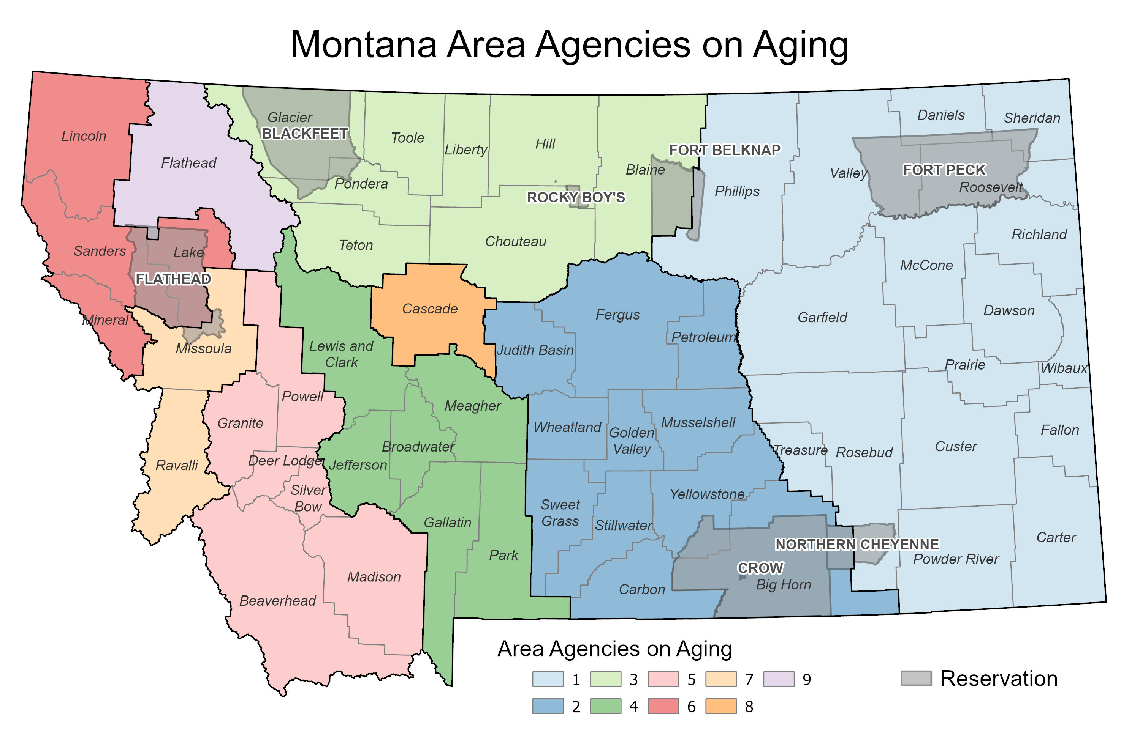
Planning & Service Areas

Slide 8

Intrastate Funding Formula (IFF)

Slide 9
IFF Taskforce
This group includes three multi-county area agency directors, the Senior and Long Term Care Division administrator, the Governor’s coordinator on aging, a representative of the Department of Commerce Census Bureau, a representative of the Snowy Mountain Economic Development Council, Aging Services Bureau staff (fiscal specialist), and the Aging Services Older Americans Act consultant.

Slide 10
IFF Requirements
Definitions
Greatest Economic Need–the need resulting from an income level at or below the poverty line.
Greatest Social Need – the need caused by non-economic factors, which include—
Physical and mental disabilities;
Language barriers; and
Cultural, social, or geographical isolation, including due to:
Native American identity;
Chronic conditions;
Housing instability, food insecurity, lack of access to reliable and clean water supply, lack of transportation, or utility assistance needs.
Any other status that threatens the capacity of the individual to live independently.

Slide 11
IFF Walk Through
Prior to the distribution of OAA funds:
SUA Administration Funds-up to $750,000 is allowable and currently Montana is setting aside $625,000. This is subject to review annually.
Up to 4% of Title IIIB State Plan administration funds are held back for the Legal Developer Program and AAAs have access to refer people to this service. Approximately half of the Title VII Elder Abuse funds are included to support the program.
Title IIIB funds are held back for the Ombudsman Program in the amount of $207,496.
Program Base -$7,777 each ($70,000 in Total) for the nine (9) Area Agencies for III-B (Supportive Services) and III-C1 (Congregate Meals).

Slide 12
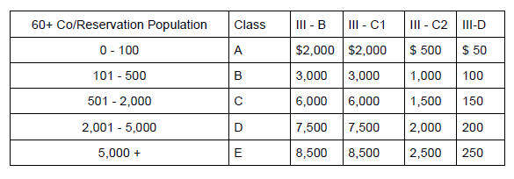
IFF Walk Through
5. Rural Base – To recognize the cost of providing services in rural areas, a rural base was established by county population from the following chart.

Slide 13
IFF Walk Through
6. Remaining Funds are distributed through the following formula (factors and weights):
Individuals at or above the age of 60: 60%
Individuals at or above the age of 60 low income: 30%
Individuals at or above the age of 60 minority: 10%
For example, each county age 60+ total population divided by the 60+ state total population = % of each three factors(Age 60+, 60+ Low Income and 60+ Minority).
State total of Age 60+ multiplied by the % of each factor = dollar amount per county for each planning and service area.

Slide 14
IFF Walk Through
7. Administration Funds – 10% of the allocated amounts for III-B and III-C1 funds are distributed on the 60/30/10 formula. Title III-C2 (Home-delivered meals), Title III-E (Caregiver Supports) and State Program Administration funds are distributed on a straight 10% of allowable funds.
a. An Administration Base of $12,000 for each of the seven (7) multi-county/reservation Area Agencies and $1,200 to the two (2) Single County Area Agencies for III-B (Supportive Services) and III-C1 (Congregate Meals).
8. And 9. No changes proposed. (Ombudsman and NSIP)
10. With respect to services for older individuals residing in rural areas, the State will not allocate, nor can an Area Agency spend less than the amount expended for services in rural areas in fiscal year 2019.

Slide 16
Impact to the Area Agencies on Aging
Difference between 70/20/10 method and 60/30/10 method (22 census)
Area 1 $13,074
Area 2 $(5,000)
Area 3 $11,182
Area 4 $(21,379)
Area 5 $3,474
Area 6 $9,914
Area 7 $(11,048)
Area 8 $3,739
Area 9 $(3,956)

Slide 17
Impact to the North Central Area Agency on Aging (Area III)
1. Geography change of the Planning and Service Area (PSA)
AAA located in Conrad will include Hill County in their PSA
2. Flexibility to allocate funds throughout the planning and service area based on the needs of older adults in the communities
Increase in funding for service provision
3. Additional administrative funding allocated to Area III for oversight of Hill County

Slide 18
New Nutrition Flexibilities
The new Older Americans Act regulations now allow states to complement the congregate meals program through an approved state plan amendment and area plan amendments. With policy and procedure updates this allows the use of pick-up, carryout, drive-through or similar meals to be provided under the Title IIIC-1 (§ 1321.87 ).
Not exceed 25 percent of the funds expended by any area agency on aging under Title IIIC–1.
Home-delivered meals eligibility criteria may include consideration of an individual’s ability to leave home unassisted, ability to shop for and prepare nutritious meals, degree of disability, or other relevant factors pertaining to their need for the service, including social and economic needs (§ 1321.87 and § 1322.27).
The SUA will work with AAAs to establish policies and procedures to exercise these new flexibilities.

Slide 19
Timeline And Submission of Public Comments

Slide 20
Timeline And Next Steps
Milestones | Proposed Timeline
Conduct 30-day public comment | March 11, 2024 – April 10, 2024
-Review public comments and finalize designation for Hill County -Review public comments and complete the Intrastate Funding Formula for ACL submission. -Finalize amendment of the State Plan on Aging for ACL submission | April 11, 2024 – May 3, 2024
ACL conducts federal review of amendment | May 3, 2024 – May 31, 2024
Effective date of Hill County AAA dissolution and transfer of oversight responsibilities and implementation of the new IFF. | July 1, 2024 (SFY 2025)

Slide 21
Ways To Provide Public Comments
Submit public comments by email, regular mail, or in-person until 11:59 pm on April 10, 2024.
By Phone | (406) 444-7788
By Email | kreidelbach@mt.gov
By Regular Mail | Redesignation for Hill County Director’s Office PO Box 4210 Helena, MT 59604-4210
In Person | Public Hearing

Slide 22
Opportunities To Provide Public Comments
DPHHS will listen and record comments
Chat may be used for public comments
All comments will be reviewed and considered equally whether they are received as written or verbal comments
DPHHS will provide responses in writing and will be available on the website

Slide 23
Public Comments

